Slide 1



Slide 2

TENSES
By –
Agharkar Makarand C.
Enroll No. 210410107075
Computer Eng. 2 (A batch)
2021-22 FY Sem2

Slide 3
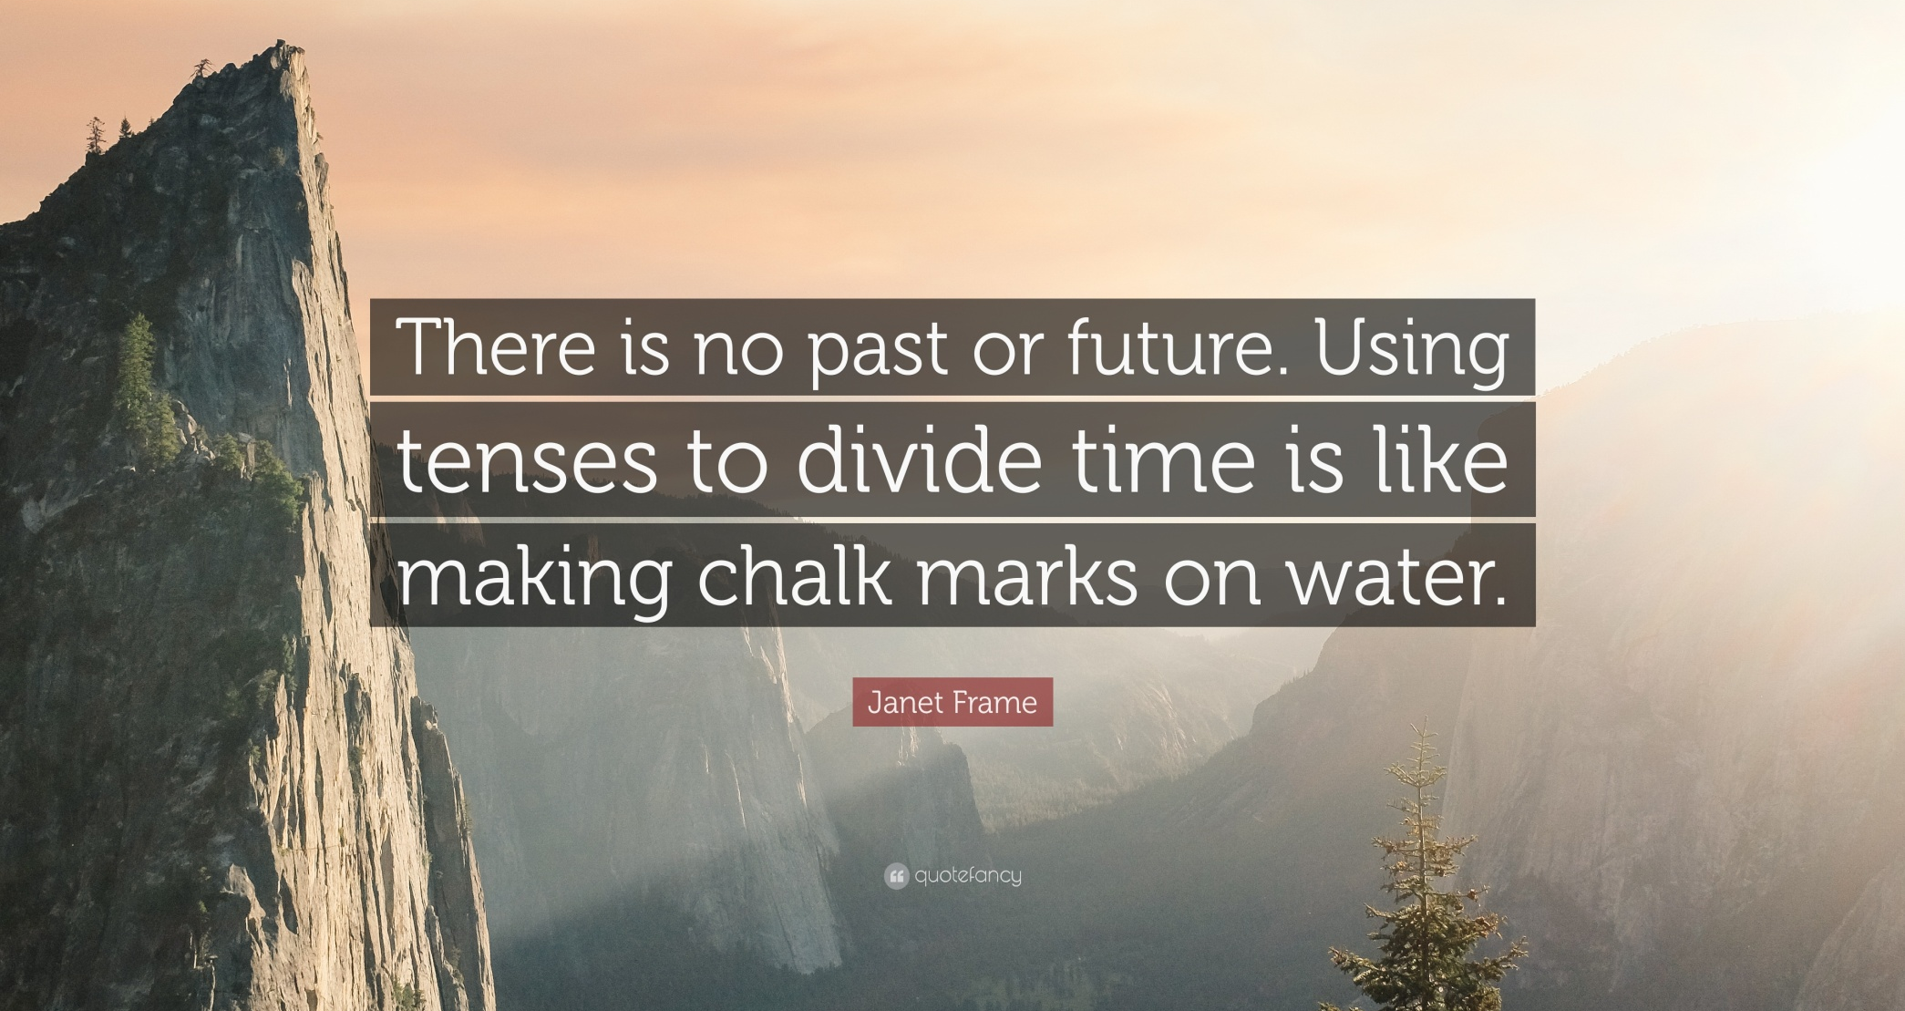
Famous Quote

Slide 4
Tense :-
The word Tense is derived from the Latin word “tempus” which means time. Tense is the time of a verb‘s action or its state of being, such as present (something happening now), past (something happened earlier), or future (something going to happen). These are called the verb's time frame.

Slide 5
Classification of Tenses based on Time Frame :-
The verb tenses may be categorized according to the time frame :
Present Tense
Past Tense
Future Tense

Slide 6
Present Tense : A tense expressing an action that is currently going on or habitually performed, or a state that currently or generally exists.
Past Tense : A tense expressing an action that has happened or a state that previously existed.
Future Tense : A tense expressing an action that has not yet happened or a state that does not yet exist, but expected to happen in the future.

Slide 7


Slide 8
Classification of Tenses based on Aspect :-
Verbs tenses may also be categorized according to Aspect.
Aspect refers to the nature of the action described by the verb.
There are four aspects :
Indefinite or Simple
Continuous or Progressive
Perfect or Complete
Perfect Continuous

Slide 9
Indefinite Tense : It describe an action but do not state whether the action is finished.
Continuous Tense : It describes an unfinished or ongoing action.
Perfect Tense : It describes a finished action.
Perfect Continuous Tense : To combine the complete tenses and the incomplete tenses, to describe an action which was in progress and then finished.

Slide 10
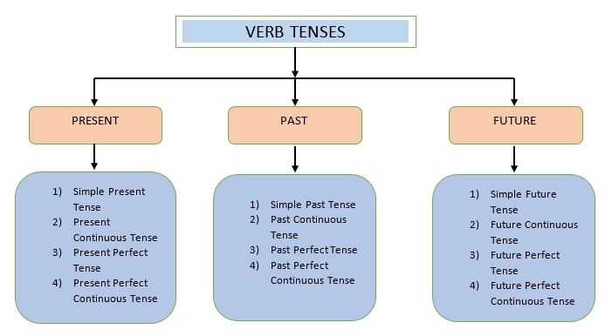
Block Diagram of Tenses

Slide 11
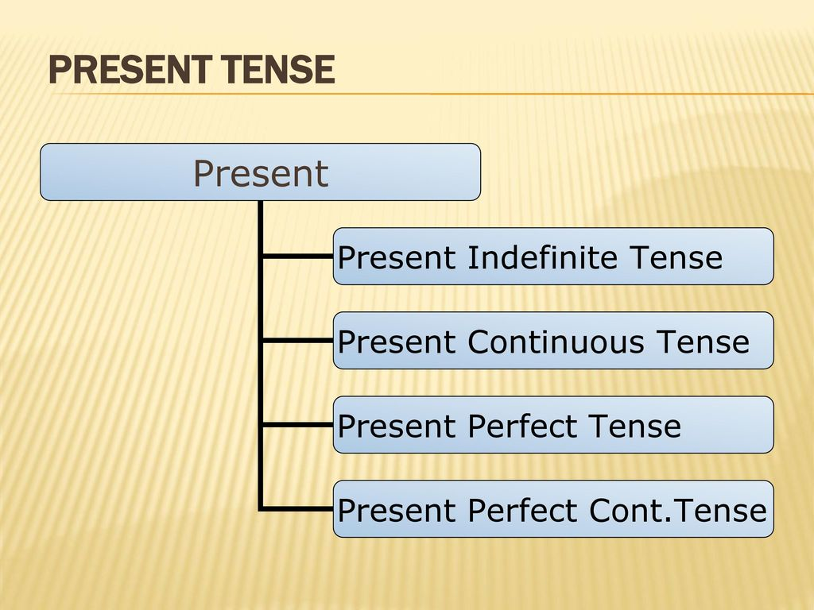
Present Tense

Slide 12
Preset Indefinite Tense
The Simple present is used to describe an action, an event, or condition that is occurring in the present, at the moment of speaking or writing. It also includes habits and universal truths.
Structure :-
Positive: Subject + V1 s/es + obj.
Negative: Subject + do/does not + V1 + Object.

Slide 13
Questions: Do/Does + Subject + V1 + object? Do/Does + Subject + not + V1 + object? Don’t/Doesn’t + Subject + V1 + object?
Example :
You sing a song.
I am not a doctor.
Are you a student ?
The sun rises in the East.
I come here daily.

Slide 14
Present Continuous Tense
The present continuous emphasizes the continuing nature of an act, event, or condition.
Structure:-
Positive: Sub + is/am/are + V1 + ing + obj
Negative: Sub + is/am/are + V1 + not + ing + obj Sub + isn’t/aren’t/am not + V1 + ing + obj
Questions: Is/am/are + Sub + V1 + ing + obj? Is/am/are + Sub + not + V1 + ing + obj? Isn’t/aren’t + Sub + V1 + ing + obj?

Slide 15
Example :
Coastal areas are getting submerged.
He is not writing.
What are you doing now ?
You see, I am eating.
I am not giving it back to you.
For events that will take place in the near future, Present Continuous Tense is used
Examples: I am going to Mumbai tomorrow.

Slide 16
Use of is/am/are
Is: he/she/it/name/singular
Am: With I
Are: With you/we/they/all/plural
If the statement deals with a routine action, Simple Present Tense is used and not Present Continuous Tense. But if the work is just a temporary routine action, Present Continuous Tense is used.
Example: I am preparing for competitive exams now-a-days.

Slide 17
Present Perfect Tense
The present perfect is used to describe action that began in past and continuous into the present or has just been completed.
Structure:
Positive: Subject + has/have + V3 + object
Negative: Subject + has/have + not + V3 + object Subject + hasn’t/haven’t + V3 +object
Questions: Has/ have + Subject + V3 + object? Has/have + Subject + not + V3 + object? Hasn’t/haven’t + Subject + V3 + object?

Slide 18
Example :
He has come to Delhi recently.
We have progressed a lot.
He has not reached home yet.
Where has your brother gone ?
She has finished her homework.
Use of Has/Have
Has–With: He/She/It/Name/Singular
Have–With: I/We/They / You / Plural / All

Slide 19
Present Perfect Continuous Tense
The present perfect continuous is used to describe an action, event, or condition that has just begun in the past and continuous into the present.
Structure :-
Positive: Sub + has/have + been + V1 + ing + obj + for/since + time.
Negative: Sub + has/have + not + been + V1 + ing + obj + for/since + time. Sub + hasn’t/haven’t + been + V1 + ing + obj + for/since + time.

Slide 20
Questions: Has/have + Sub + been + V1 + ing + obj + for/since + time? Has/have + Sub + not + been + V1 + ing + obj + for/since + time? Hasn’t/haven’t + Sub + been + V1 + ing + obj + for/since + time?
Examples :
I have been teaching you for an hour.
We have not been playing cricket since morning.
Has he been playing game since morning ?

Slide 21
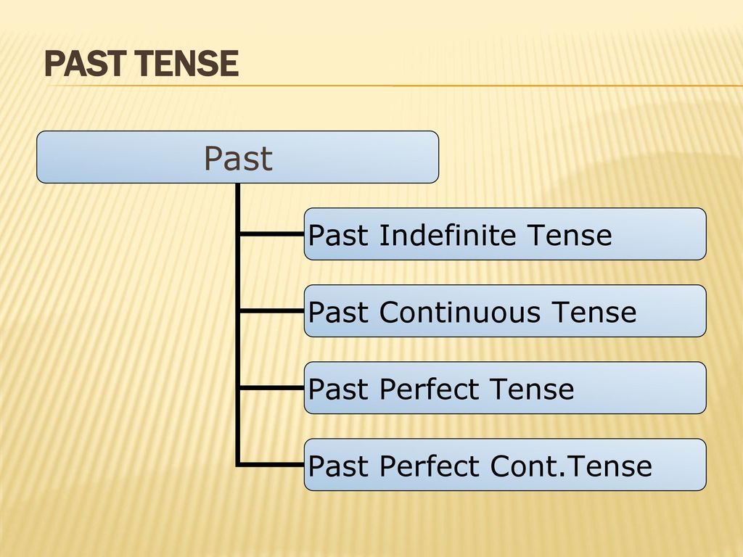
Past Tense

Slide 22
Past Indefinite Tense
The simple past is used to describe an action, an event, or condition that occurred in the past.
Structure :-
Positive: Subject + V2 + Object
Negative: Subject + Did not (didn’t) + V1 + Object
Questions: Did + Subject + V1 + Object? Didn’t + Subject + V1 + Object?

Slide 23
Examples :
He did make a mistake.
I came yesterday.
Did you sing the song on stage?
I didn’t write a letter last week.
She woke up early in the morning.
How long did the flight journey take?

Slide 24
Past Continuous Tense
The past continuous is used to describe actions ongoing in the past.
Structure :-
Positive: Sub + was/were + V1 + ing + obj
Negative: Sub + was/were + not + V1 + ing + obj Sub + wasn’t/weren’t + V1 + ing + obj
Questions:
Was/Were + Sub + V1 + ing + obj? Was/Were + Sub + not + V1 + ing + obj? Wasn’t/weren’t + Sub + V1 + ing + obj?

Slide 25
Examples :
I was waiting for you.
She wasn’t watching the movie.
Was I washing the dishes when the bell rang?
The earthquake was scaring all of us.
I was not writing a letter.
Use of was and were
Was – I/He/she/it/name/singular.
Were – You/we/they/plural/all.

Slide 26
Past Perfect Tense
The past perfect is used to refer to action that took place and were completed in the past.
Structure :-
Positive: Subject + Had + V3 + object
Negative: Subject + Had + not + V3 + object
Questions: Had + Subject + V3 + object? Had + Subject + not + V3 + object? Hadn’t + Subject + V3 + object?

Slide 27
Examples :
We had played video games.
I had told all the information.
You hadn’t studied hard.
Had she done her homework?
If two actions take place in the past, one after the other, the 1st action will be in Past Perfect Tense and the 2nd action will be in Simple Past Tense.
Example- I had seen him before he stopped his car.

Slide 28
Past Perfect Continuous Tense
The past perfect continuous is used to indicate that a action in the past began before another past action began or interrupted the first action.
Structure :-
Positive: Sub + had + been + V1 + ing + obj + for/since + time.
Negative: Sub + had + not + been + V1 + ing + obj + for/since + time.

Slide 29
Questions: Had + sub + not + been + V1 + ing + obj + for/since + time ? Hadn’t + sub + been + V1 + ing + obj + for/since + time ?
Examples :
I had been waiting for you since morning.
He had not been reading books for five months.
Had the actor been working since morning?

Slide 30
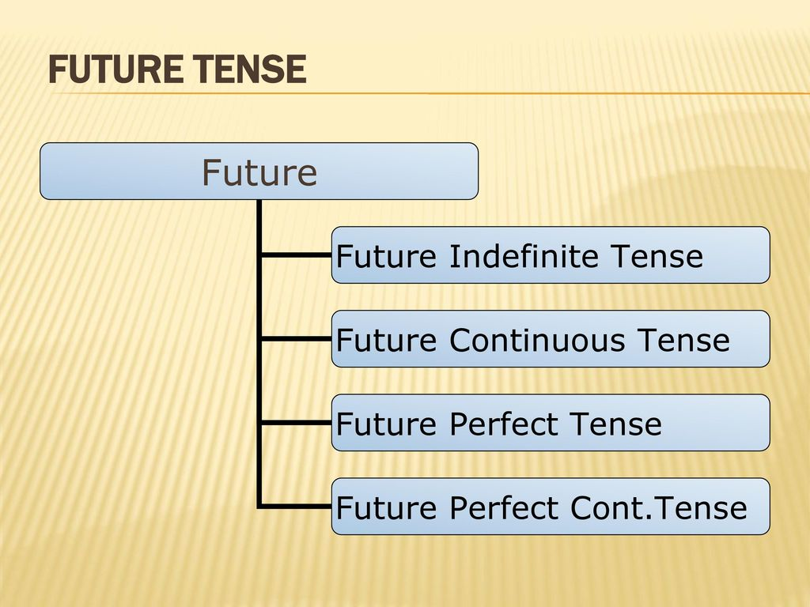
Future Tense

Slide 31
Future Indefinite Tense
The simple future is used to refer to action that will take place in future.
Structure :-
Positive: Sub + Shall/will + V1 + obj
Negative: Sub + shall/will + not + V1 + obj
Questions: Shall/Will + Sub + V1 + obj? Shall/Will + Sub + not + V1 + obj? Shan’t/won’t + Sub + V1 + obj?

Slide 32
Examples :
I shall meet you tomorrow.
She will come to the party.
He will not call us.
Will you wait for me?
Use of Will/Shall
Will – second and third person (he, she, you)
Shall – first person (I and we)

Slide 33
Future Continuous Tense
The future continuous is used to describe actions ongoing in the future.
Structure :-
Positive: Subject + shall/will + be + V1 + ing + object
Negative: Subject + shall/will + not + be + V1 + ing + object Subject + shan’t/won’t + be + V1 + ing +obj

Slide 34
Questions: Will/Shall + Subject + be + V1 + ing + obj Will/Shall + Subject + not + be + V1 + ing + obj Won’t/Shan’t + Subject + be + V1 + ing +obj
Examples :
She will be singing at home.
They will not be writing letter to each other.
Will you be waiting for me?

Slide 35
Future Perfect Tense
The future perfect is used to refer to an action that will be completed sometime in the future before another action take place.
Structure :-
Positive: Subject + will/shall + have + V3 + obj
Negative: Subject + will/shall + not + have + V3 + obj Subject + won’t/shan’t + have + V3 + obj

Slide 36
Questions: Will/shall + sub + have + V3 + Obj? Will/shall + sub + not + have + V3 + Obj? Won’t/shan’t + sub + have + V3 + Obj?
Examples :
We will have written a letter.
The rain will not have stopped by tomorrow.
Will they have gone home by then?
The will have played cricket.

Slide 37
Future Perfect Continuous Tense
The future perfect continuous is used to indicate a continuing action that will be completed at some specified time in the future.
Structure :-
Positive: Sub + Shall/will + have + been + V1 + ing + obj + for/since + time.
Negative: Sub + Shall/will + not + have + been + V1 + ing + obj + for/since + time. Sub + Shan’t/won’t + have + been + V1 + ing + obj + for/since + time.

Slide 38
Questions: Shall/will + sub + have + been + V1 + ing + obj + for/from + time? Shan’t/won’t l + sub + have + been + V1 + ing + obj + for/from + time?
Examples :
She will have been shopping for the whole day.
I will not have been staying in Delhi next summer.
Will he have been waiting for me since morning?

Slide 39
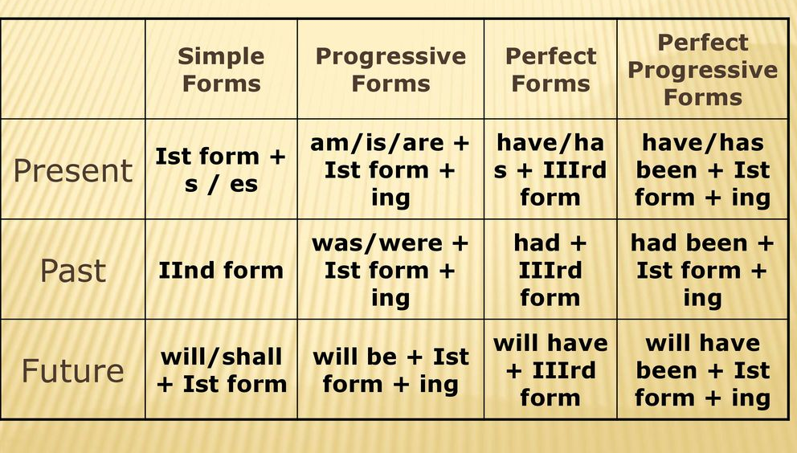
List of Rules of Tenses

Slide 40
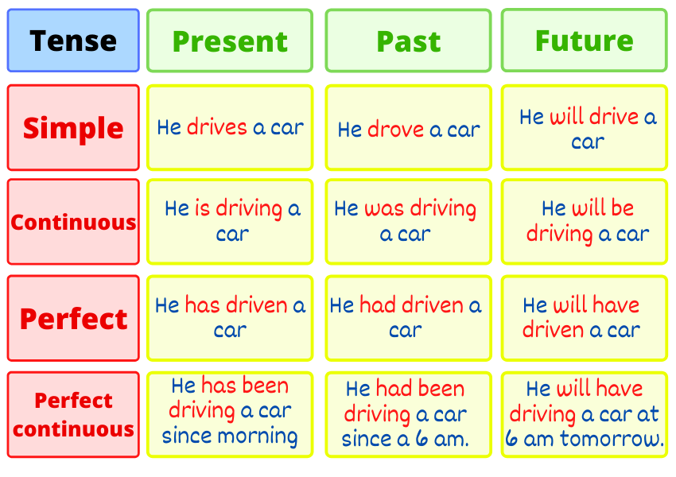
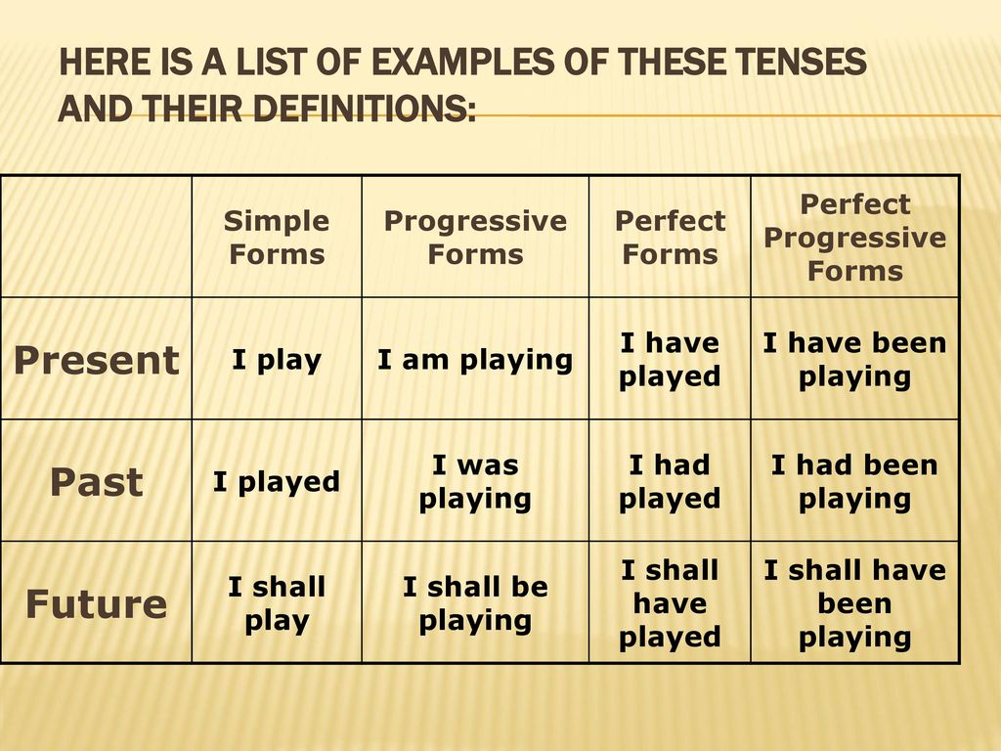
List of Examples

Slide 41
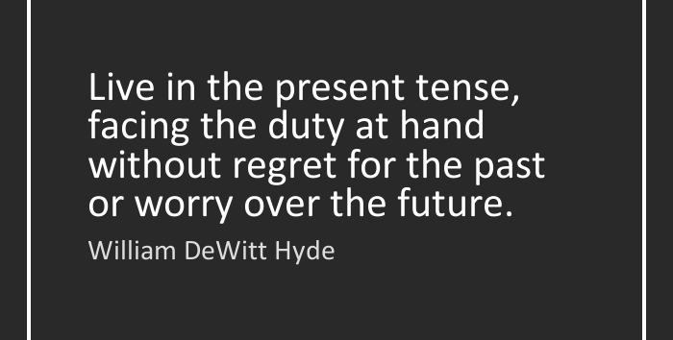
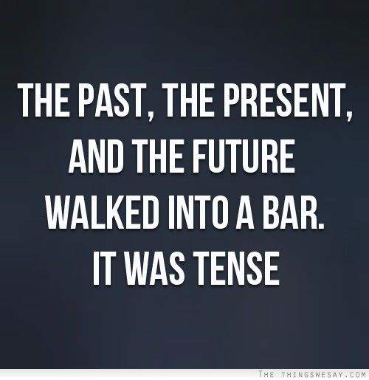
Thank You

